Slide 1
Mockup Aplikasi Rekrutmen
By: Kristina Sitinjak

Slide 2
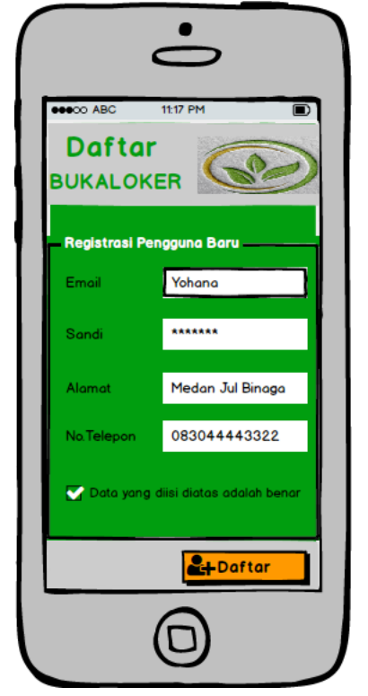
Fitur Pendaftaran Akun

Slide 3
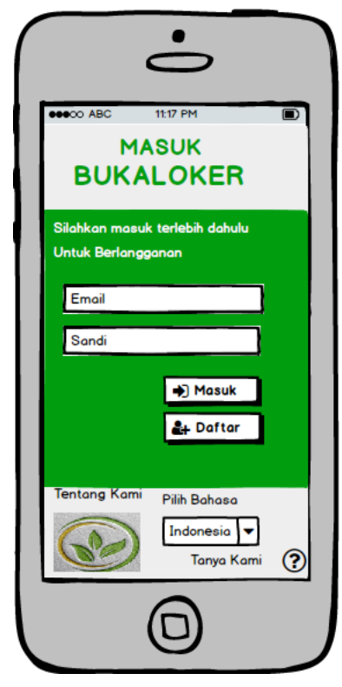
Fitur Login

Slide 4
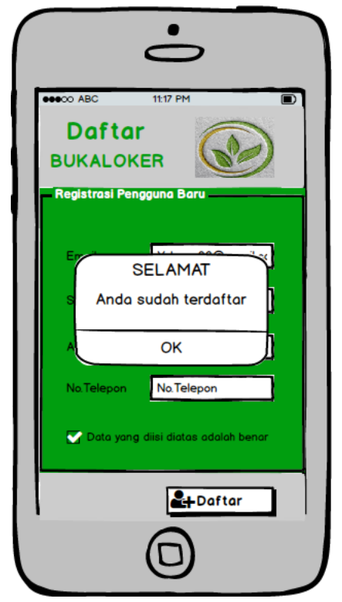
Halaman Konfirmasi Akun

Slide 5
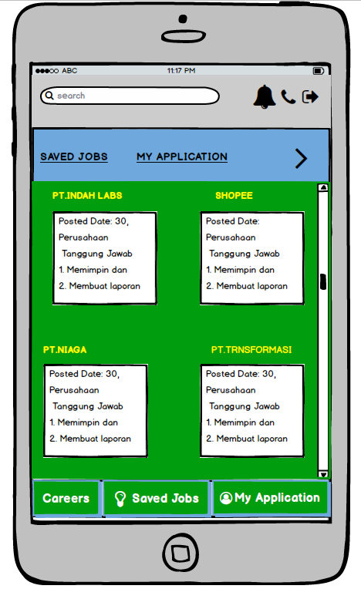
Home Page

Slide 6
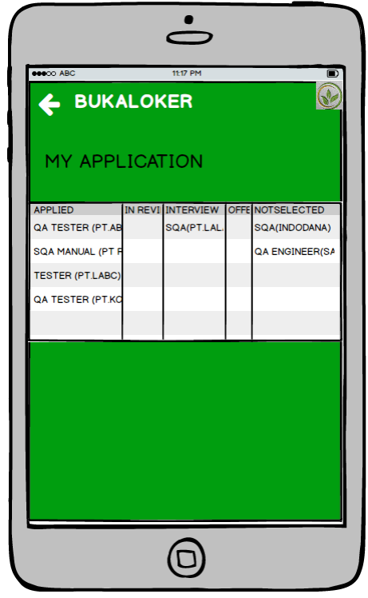
My Application Page

Slide 7
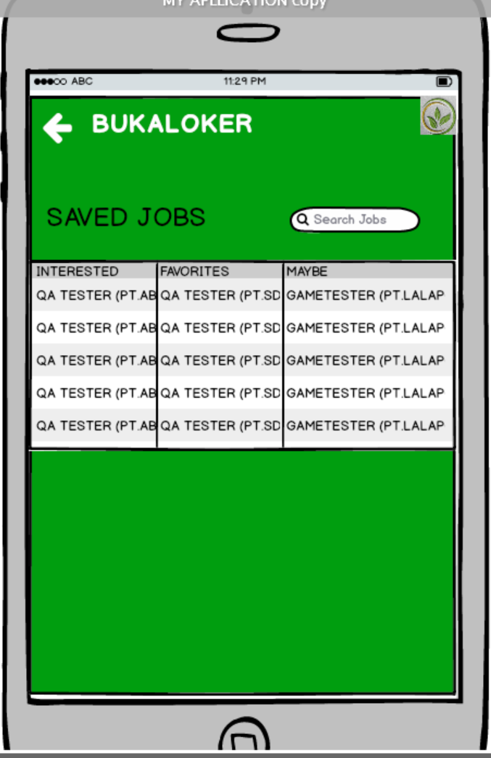
Saved Jobs Page

Slide 8
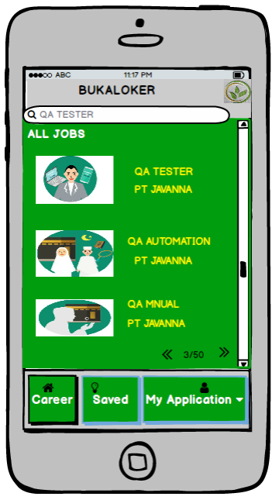
Search Page

Slide 9
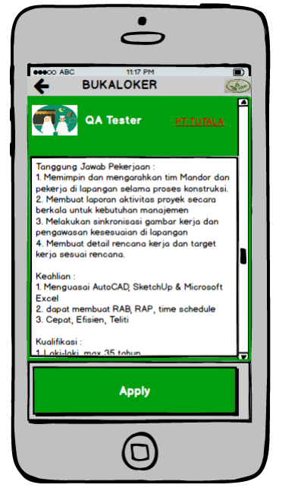
Detail Page

Slide 10
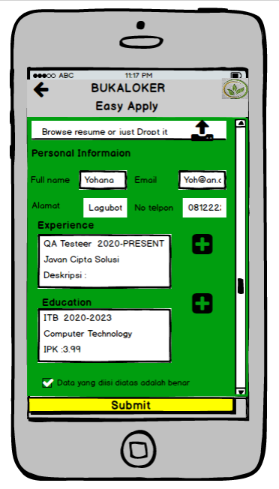
Apply form Page

Slide 11
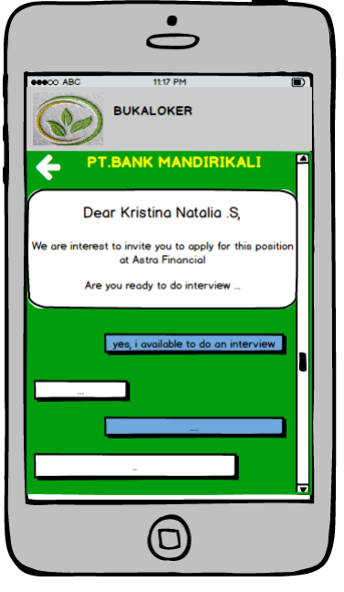
Message Page

Slide 12
